Slide 1
EESC EXPERT HEARING · DIGITAL FAIRNESS ACT
Dark Patterns Are
Only the Surface
01
ACADEMIC
Associate Professor of AI, Digital Regulation and Disruptive Technology · Riga Graduate School of Law
What the Digital Fairness Act must regulate — and in what order
RESEARCH
02
Author · Dark Patterns, Deceptive Design, and the Law · AI, Neurodata and Society
Dr Mark Leiser
Academic and technology law consultant
03
EVIDENCE
Co-runs deceptive.design with Harry Brignull · enforcement database and taxonomy
04
POLICY + PRACTICE
Director · DigiData Consulting · final European Commission study on AI Act Article 5(1)(a) and (b)
The screen is the delivery surface.
The commercial practice is the regulatory object.
Brussels · 9 September 2026
EESC · DIGITAL FAIRNESS ACT · 9 SEPTEMBER 2026
01

Slide 2

THE CONCEPTUAL PROBLEM
The dark-pattern frame
is conceptually too small
The visible interface is one layer of the consumer environment.
SURFACE
UI dark patterns
words · buttons · defaults · friction
JOURNEY
deceptive design
sequence · timing · repetition · ranking
PRACTICE
commercial practice
objective · experiments · allocation · outcomes
Regulate the practice that creates the choice environment — not only the visible symptom.
EESC · DIGITAL FAIRNESS ACT · 9 SEPTEMBER 2026
02

Slide 3
WHAT THE CONSUMER CANNOT SEE
One journey for the consumer.
A portfolio of experiments for the trader.
A screenshot can capture treatment; it cannot reveal selection, optimisation or group effects.
ELENA SEES
THE TRADER CONTROLS
OBJECTIVE
VARIANTS
RETENTION OFFER
retention · complaint deflection
six flows · continuous A/B testing
PAUSE
delivers
one route
ALLOCATION
ENGINE
DOWNGRADE
CALL SUPPORT
SIGNALS + INFERENCE
OUTCOMES
history · timing · predicted susceptibility
drop-off · surrender · reversal
EXIT
one route · one visible sequence
A screenshot captures the treatment. It cannot reveal why the treatment was selected.
EESC · DIGITAL FAIRNESS ACT · 9 SEPTEMBER 2026
03

Slide 4
THE CORRECT OBJECT OF ASSESSMENT
The whole consumer environment must fall within scope
Six evidential questions expose the mechanism.
The journey supplies the unit of analysis.
SEQUENCE
FEATURE
what came before and after?
OBJECTIVE
wording · prominence · default · friction
what outcome did the trader reward?
COMMERCIAL
PRACTICE
what happened?
CONTEXT
ADAPTATION
stakes · benchmark · vulnerability · alternatives
what data or inference changed the route?
OUTCOME
comprehension · choice · rights · loss
THE JOURNEY IS THE UNIT OF ANALYSIS
Evidential grammar — not six cumulative elements of a new offence.
ADVERTISE
ONBOARD
BUY / RENEW
CANCEL
COMPLAIN / REDRESS
EESC · DIGITAL FAIRNESS ACT · 9 SEPTEMBER 2026
04

Slide 5
THE LEGISLATIVE SEQUENCE
Regulate in the right order
The lectures form one legal architecture: object, gate, benchmark and operating model.
01
LECTURE 2
02
LECTURE 3
03
LECTURE 4
04
LECTURE 5
OBJECT
GATE
BENCHMARK
OPERATION
INSPECT BROADLY
PROHIBIT PRECISELY
SUPPORT, NOT EXTRACTION
INSPECT · PROVE · REMEDY
Inspect the commercial practice across interface, journey, objective and allocation.
Use narrow red lines where justified; otherwise retain actual or likely material distortion.
Follow the targeted group. Treat vulnerability as relational, not as permanent incapacity.
Open evidence at a lower trigger; prove infringement; remedy only the mechanism established.
ARCHITECTURE WIDENS THE EVIDENTIAL FIELD. MATERIAL DISTORTION CONTROLS LIABILITY.
EESC · DIGITAL FAIRNESS ACT · 9 SEPTEMBER 2026
05

Slide 6
THE LEGAL TOOLKIT
One feature blacklist cannot do four different jobs
The DFA needs precise red lines, contestable inferences, inspectable evidence and a durable general gate.
LEVERS
WHEN TO USE THEM
LEGAL JOB
1
NARROW RED LINES
Observable conduct, objectively defined, with negligible legitimate use.
PROHIBIT
2
REBUTTABLE PRESUMPTIONS
Specified facts, a defined inference and a genuine opportunity to rebut.
INFER
3
EVIDENCE + GOVERNANCE DUTIES
Purpose, objectives, variants, allocation criteria, journey logs, outcomes and change history.
INSPECT
4
GENERAL UNFAIRNESS GATE
Professional diligence plus actual or likely material distortion for novel or context-dependent practices.
DECIDE
PROPORTIONALITY · Bounded, consumer-supportive and inspectable systems may earn a conditional, revocable safe harbour.
EESC · DIGITAL FAIRNESS ACT · 9 SEPTEMBER 2026
06

Slide 7
THE EESC RECOMMENDATION
A two-threshold operating model — with remedies that track the mechanism
Preserve the legal line. Remove the evidential blind spot.
THRESHOLD 1
PRESERVE + PRODUCE
THRESHOLD 2
DRAFTING CONSEQUENCES
CREDIBLE INDICATOR
EVIDENCE PACK
STATUTORY PROOF
3.3 / 4.9
Describe Article 25 DSA as scoped — not as a blanket dark-pattern ban.
suspect objective · adaptive route · rights obstruction · vulnerability exposure
purpose · variants · allocation · logs · outcomes · controlled access
Annex I · Articles 6–9 · Article 5(2)
REMEDIES CLIMB ONLY AS PROOF REQUIRES
4.10
Tie evidence duties to control, opacity and risk — not company size alone.
1
2
3
4
CORRECT
REMOVE OBJECTIVE
REDESIGN JOURNEY
STRUCTURAL ORDER
refund · reversal · restore the right
stop abandonment, delay or extraction metrics
timing · ranking · disclosure · refusal
only if persistence is proved
4.13
Keep actual or likely material distortion. Do not require realised harm or subjective intent.
SAME LEGAL LINE · BETTER EVIDENCE · REMEDIES WITH A CAUSAL SPINE
EESC · DIGITAL FAIRNESS ACT · 9 SEPTEMBER 2026
07

Slide 8

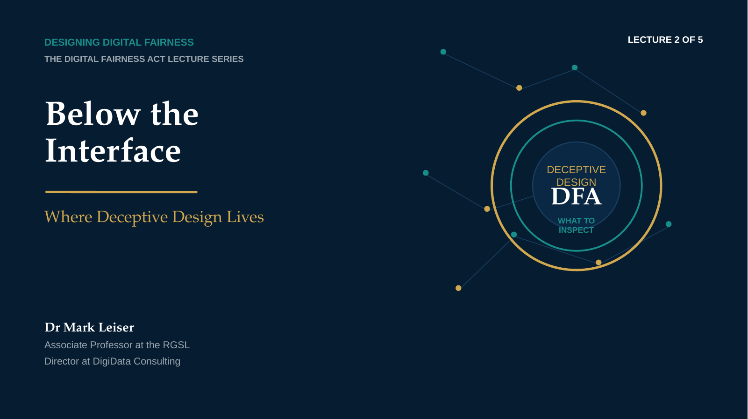
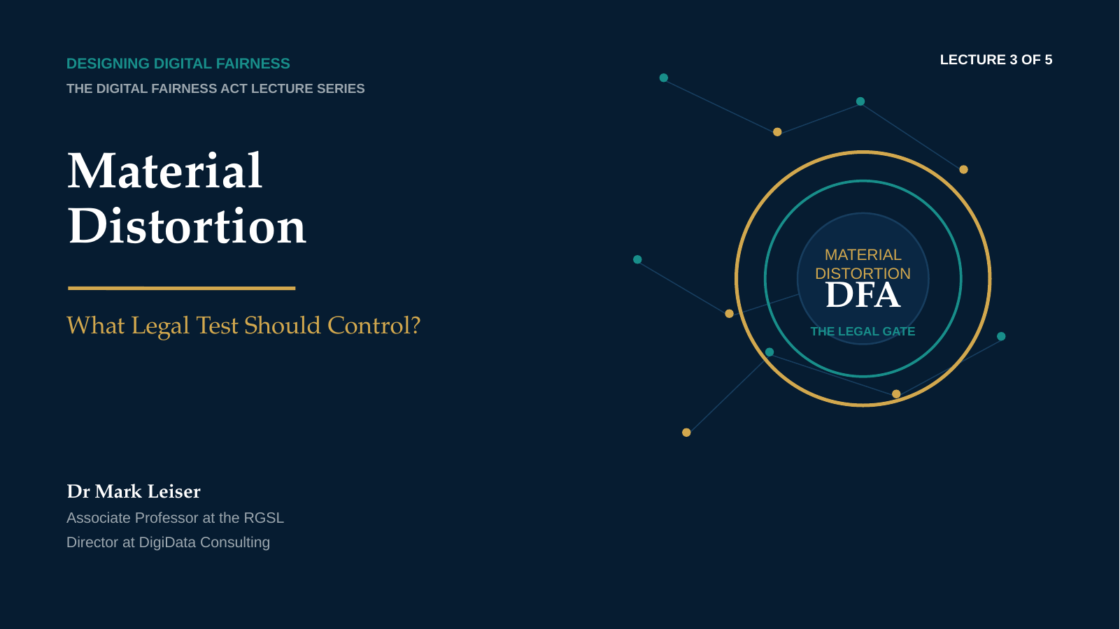
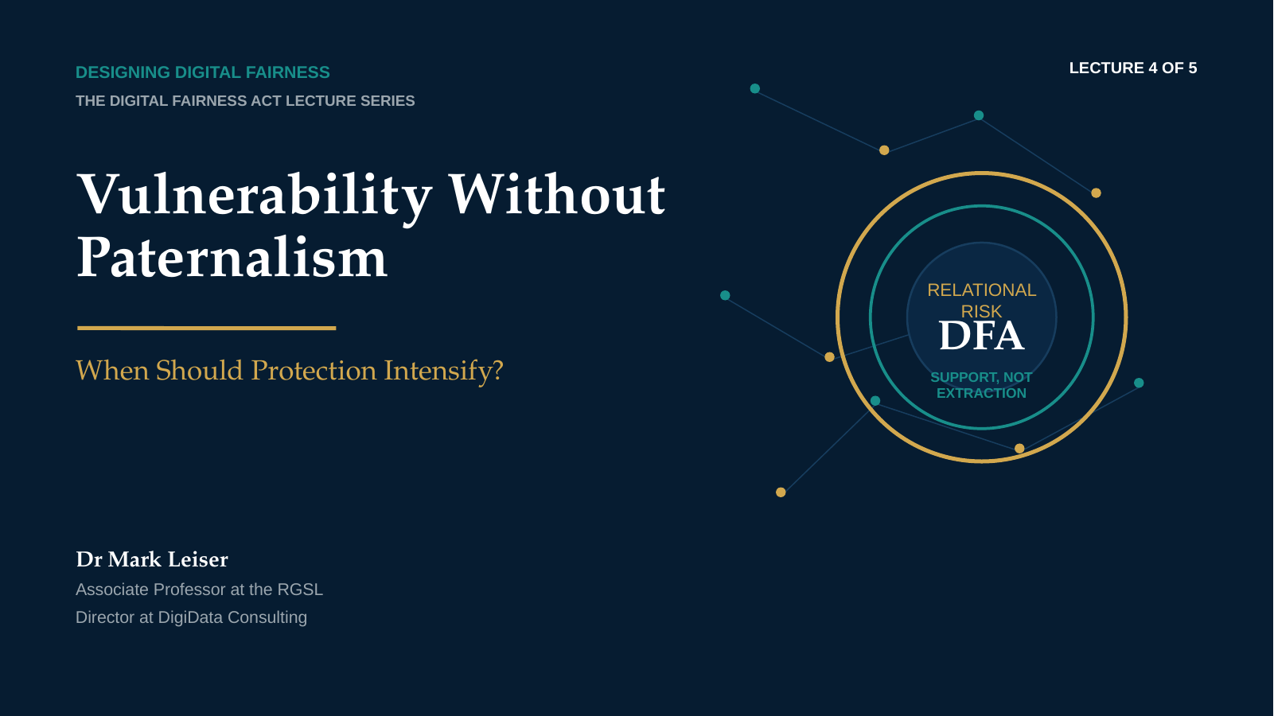
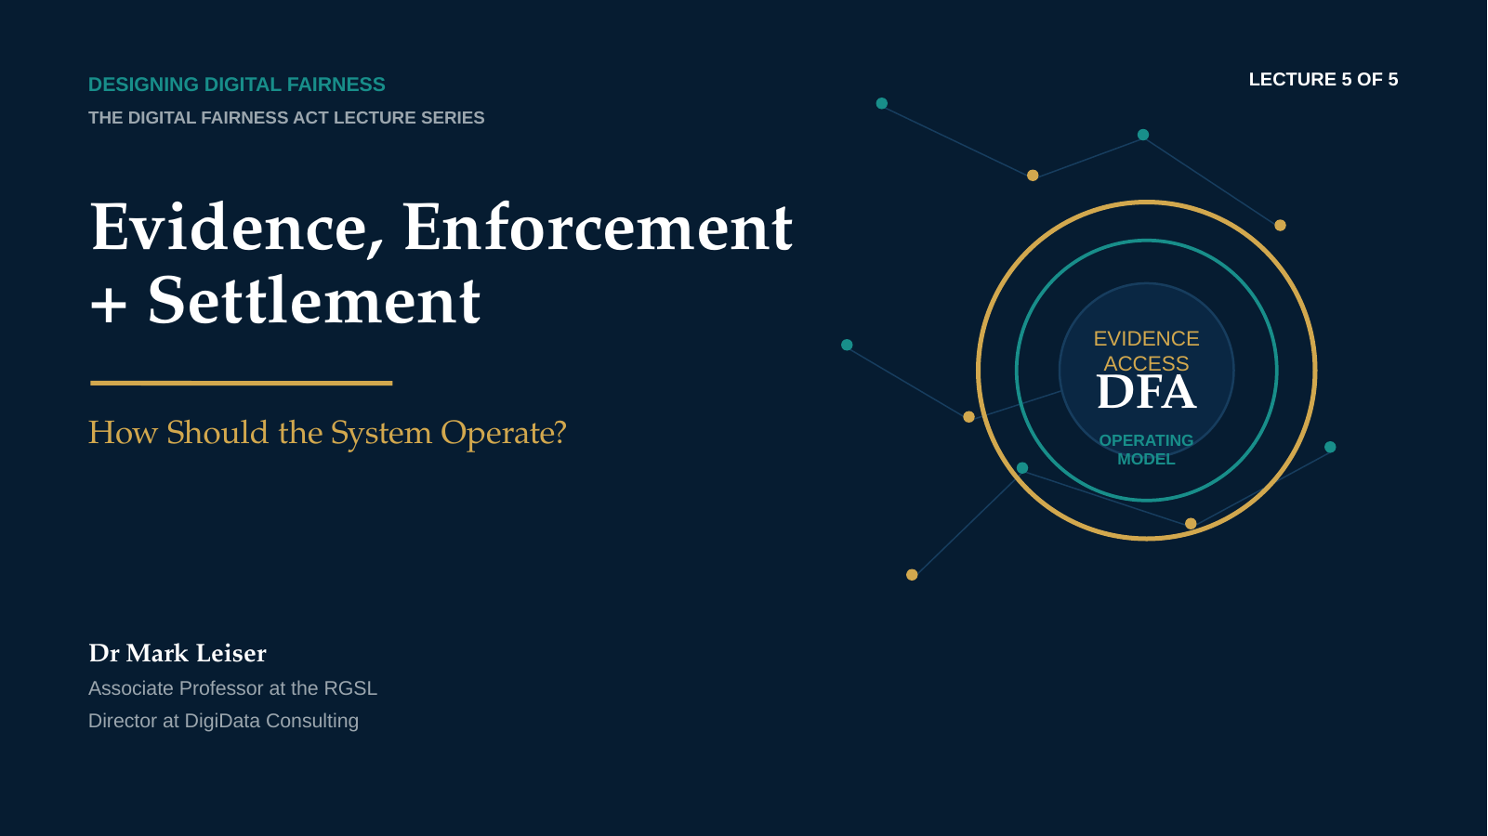

CONTINUE THE ARGUMENT
The full argument, in order
Five expert lectures on what the Digital Fairness Act must regulate and how the system should work.
1
STATUS
2
OBJECT
3
LEGAL GATE
4
VULNERABILITY
5
ENFORCEMENT
THE DIGITAL FAIRNESS ACT
What Europe Must Get Right
Status · deceptive design below the interface · material distortion · vulnerability without paternalism · evidence and enforcement
https://www.youtube.com/playlist?list=PLJ-Hkr2cMyUs
SCAN TO WATCH
FULL FIVE-PART PLAYLIST
EESC · DIGITAL FAIRNESS ACT · 9 SEPTEMBER 2026
08

